Slide 1
Food processing discussion
Notes:
Stock image of cloud formations

Slide 2
Food processing work overview
Goal: break out food processing from “other industry”
Food processing
Process heat
Biomass
Coal
Gas
Refined liquids
Electricity
Solar thermal
Geothermal heat pumps
Electricity
Heat
Food
Food demand
Proposed plan:
Break out food processing simply, with a demand set by income and price elasticities, as typical for GCAM industries
Implement a one-directional linkage between food demand and food processing energy use, where food demand (output calories) sets the scale of food processing energy use
Explore effect of food processing energy use on food production (just check)

Slide 3
Food processing work overview
Goal: break out food processing from “other industry”
Proposed plan:
Break out food processing simply, with a demand set by income and price elasticities, as typical for GCAM industries
Implement a one-directional linkage between food demand and food processing energy use, where food demand (output calories) sets the scale of food processing energy use
Explore effect of food processing energy use on food production (just check)
Progress since December:
Functioning breakout for food processing sector (but with default assumptions for almost everything), including non-CO₂ emissions
Initial explorations of the relationship between food processing energy use and food production

Slide 4
Food processing work overview
Goal: break out food processing from “other industry”
Proposed plan:
Break out food processing simply, with a demand set by income and price elasticities, as typical for GCAM industries
Implement a one-directional linkage between food demand and food processing energy use, where food demand (output calories) sets the scale of food processing energy use
Explore effect of food processing energy use on food production (just check)
Progress since December:
Next steps:
Functioning breakout for food processing sector (but with default assumptions for almost everything), including non-CO₂ emissions
Revise assumptions (starting with cost – GTAP data?)
Refine non-CO₂ emissions
Break out water consumption
Allocate historical cogen
Initial explorations of the relationship between food processing energy use and food production
Continue to revise the analysis
Implement linkage

Slide 5
Food processing work overview
Goal: break out food processing from “other industry”
Proposed plan:
Break out food processing simply, with a demand set by income and price elasticities, as typical for GCAM industries
Implement a one-directional linkage between food demand and food processing energy use, where food demand (output calories) sets the scale of food processing energy use
Explore effect of food processing energy use on food production (just check)
Progress since December:
Next steps:
Functioning breakout for food processing sector (but with default assumptions for almost everything), including non-CO₂ emissions
Revise assumptions (starting with cost – GTAP data?)
Refine non-CO₂ emissions
Break out water consumption
Allocate historical cogen
Initial explorations of the relationship between food processing energy use and food production
Continue to revise the analysis
Implement linkage

Slide 6
Current breakout status
Inputs to process heat food processing by technology
EJ
(note: mostly default assumptions)

Slide 7
Current breakout status
Inputs to food processing
EJ
(note: mostly default assumptions)

Slide 8
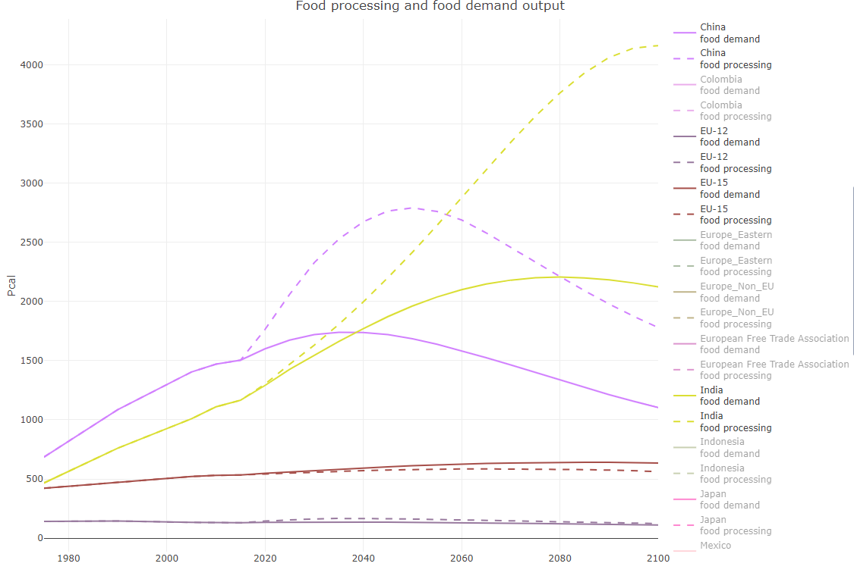
Current breakout status
Food processing output (in calories, set by income and price elasticities) compared to food demand output
(note: mostly default assumptions)
Notes:
Generally, tends to overestimate food output for developing regions, underestimate for developed regions (specifically Europe and US)

Slide 9
Current breakout challenges
Allocating cogen to food processing
→ to do, likely based on share of overall fuel use
Allocating some of “other industrial energy use” to food processing
→ will be addressed using the derived relationship between food production and food processing energy use
Allocating some electricity consumption to process heat (rather than direct use)
→ currently implemented as allocating some electricity to process heat if, in all years, the fraction of food processing energy use that is supplied by electricity is > 0.6; could be refined (and may not be necessary once the reallocation of energy use is complete)

Slide 10
Food processing work overview
Goal: break out food processing from “other industry”
Proposed plan:
Break out food processing simply, with a demand set by income and price elasticities, as typical for GCAM industries
Implement a one-directional linkage between food demand and food processing energy use, where food demand (output calories) sets the scale of food processing energy use
Explore effect of food processing energy use on food production (just check)
Progress since December:
Next steps:
Functioning breakout for food processing sector (but with default assumptions for almost everything), including non-CO₂ emissions
Revise assumptions (starting with cost – GTAP data?)
Refine non-CO₂ emissions
Break out water consumption
Allocate historical cogen
Initial explorations of the relationship between food processing energy use and food production
Continue to revise the analysis
Implement linkage

Slide 11
Food processing energy use and food production
Initial model:
Food processing energy use ~ food production + GDP per capita + conversion rate of food to calories
+ interaction term: production*GDP per capita
+ interaction term: production*conversion rate of food to calories
At a country level
Tried for just 2010-2015 (better food production data) and for 1971-2015
Different options for which regions to include in the analysis
All regions and years with nonzero food processing energy use and food production
Limiting based on the fraction of total industry energy that is in “non-specified energy use” (either overall or by fuel)
Limiting based on the fraction of total industry energy that is in food processing

Slide 12
Food processing energy use and food production
Initial model:
Food processing energy use ~ food production + GDP per capita + conversion rate of food to calories
+ interaction term: production*GDP per capita
+ interaction term: production*conversion rate of food to calories
Notes:
Food processing energy use data range is ~0-1.85 EJ
Food production range is ~0.0002-1.7 PKcal
cal per g range is ~1,000-3000
GDP per capita range is ~0.3-115 thousand 2015$/person

Slide 13
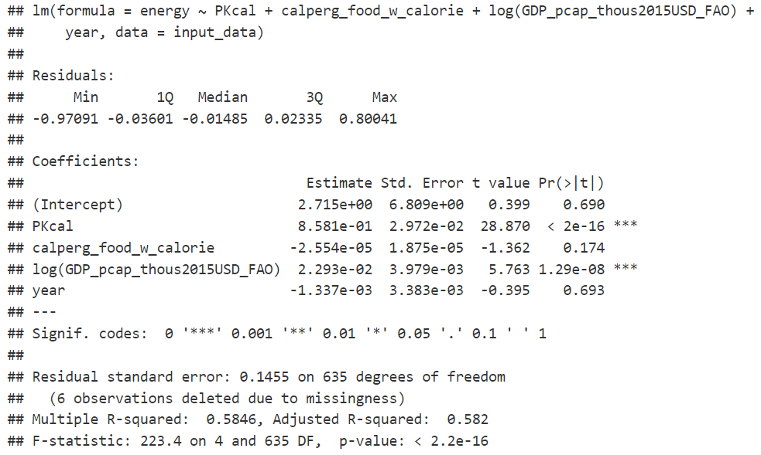
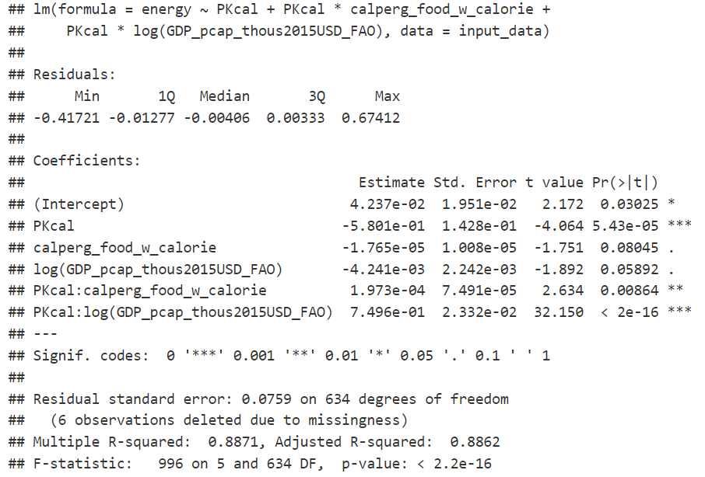
Food processing energy use and food production
Initial model:
Food processing energy use ~ food production + GDP per capita + conversion rate of food to calories
+ interaction term: production*GDP per capita
+ interaction term: production*conversion rate of food to calories
2010-2015, all regions and years with nonzero food processing energy use and food production (~650 observations)

Slide 14
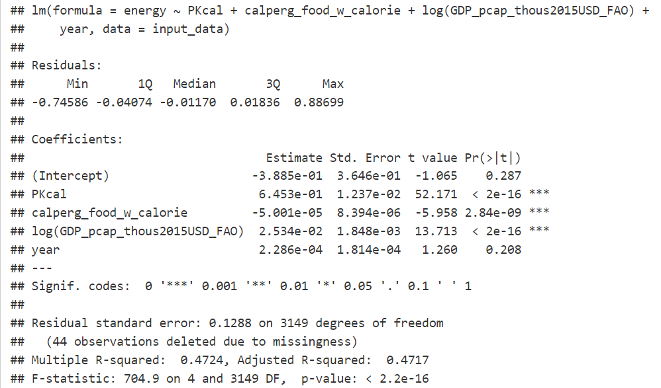
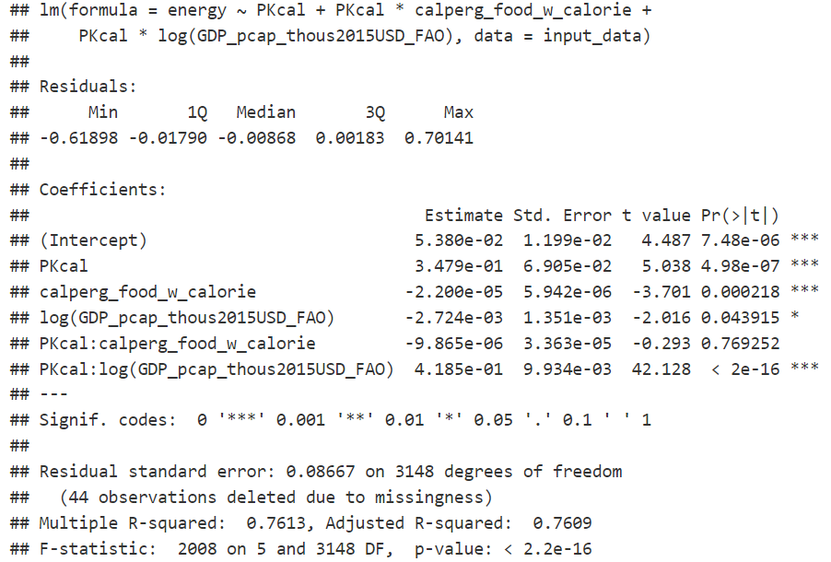
Food processing energy use and food production
Initial model:
Food processing energy use ~ food production + GDP per capita + conversion rate of food to calories
+ interaction term: production*GDP per capita
+ interaction term: production*conversion rate of food to calories
1971-2015, all regions and years with nonzero food processing energy use and food production (~3150 observations)

Slide 15
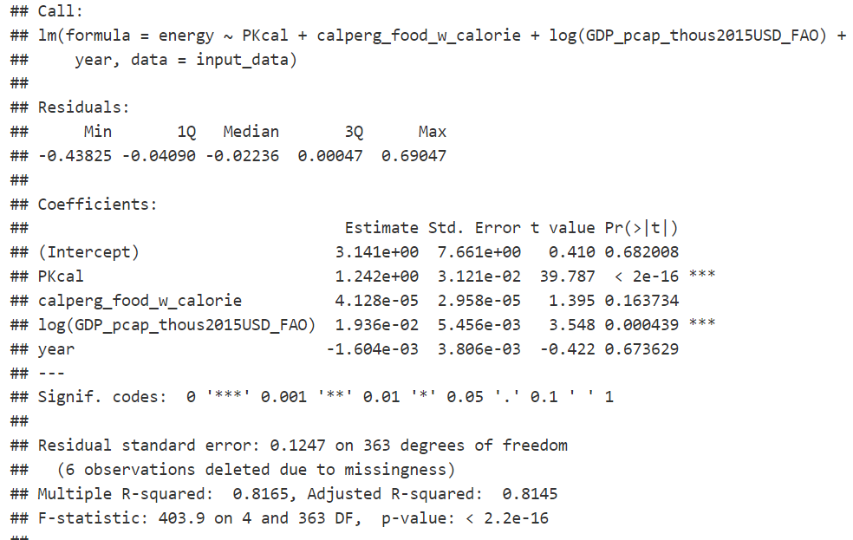
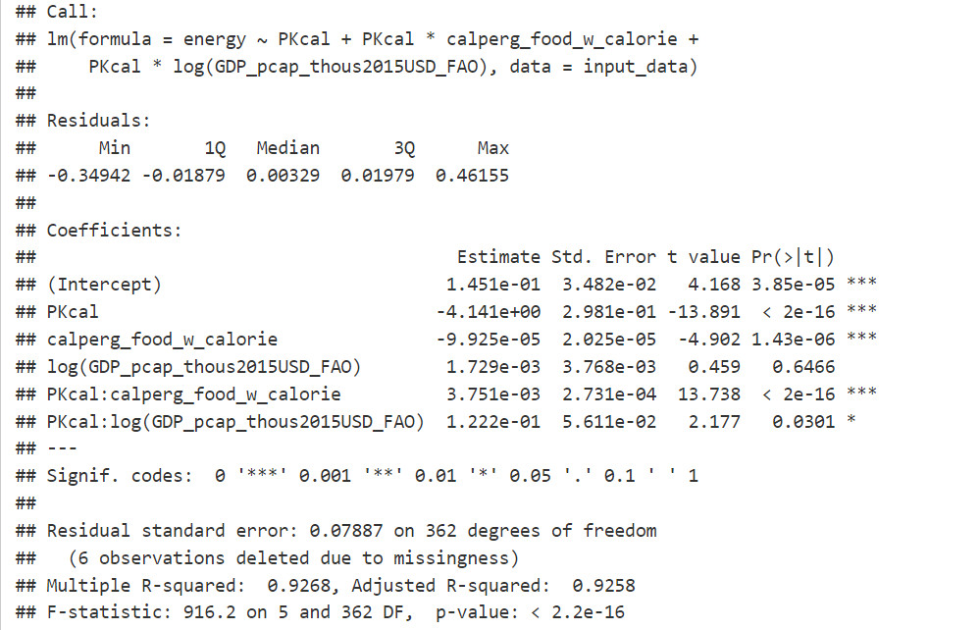
Food processing energy use and food production
Initial model:
Food processing energy use ~ food production + GDP per capita + conversion rate of food to calories
+ interaction term: production*GDP per capita
+ interaction term: production*conversion rate of food to calories
2010-2015, all regions and years with nonzero food processing energy use and food production, and where no fuels are fully allocated to other industry (~370 observations)

Slide 16
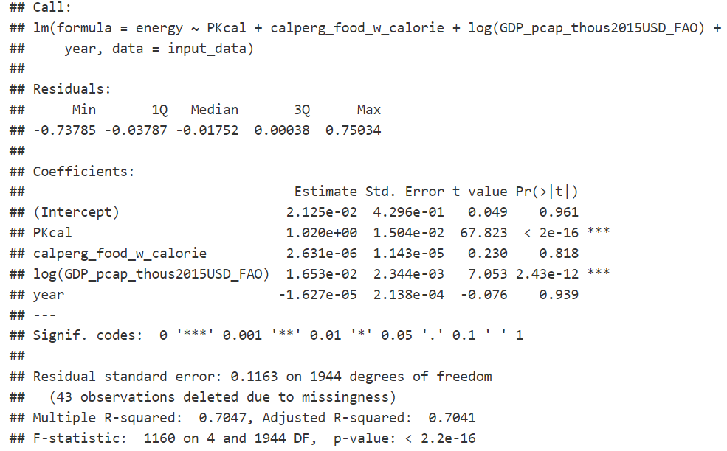
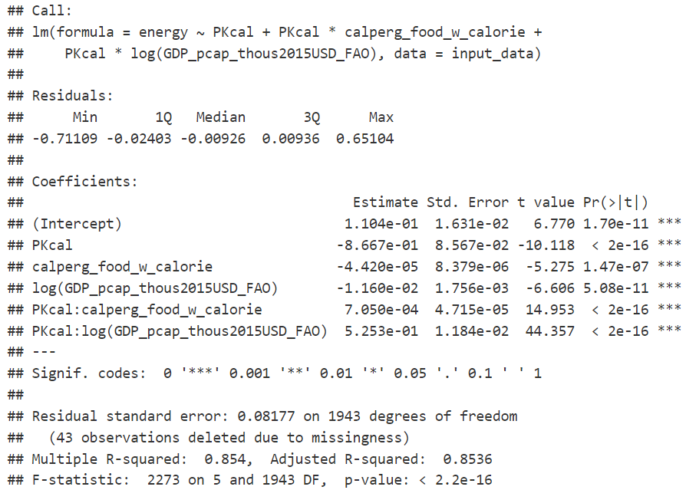
Food processing energy use and food production
Initial model:
Food processing energy use ~ food production + GDP per capita + conversion rate of food to calories
+ interaction term: production*GDP per capita
+ interaction term: production*conversion rate of food to calories
1971-2015, all regions and years with nonzero food processing energy use and food production, and where no fuels are fully allocated to other industry (~1950 observations)

Slide 17
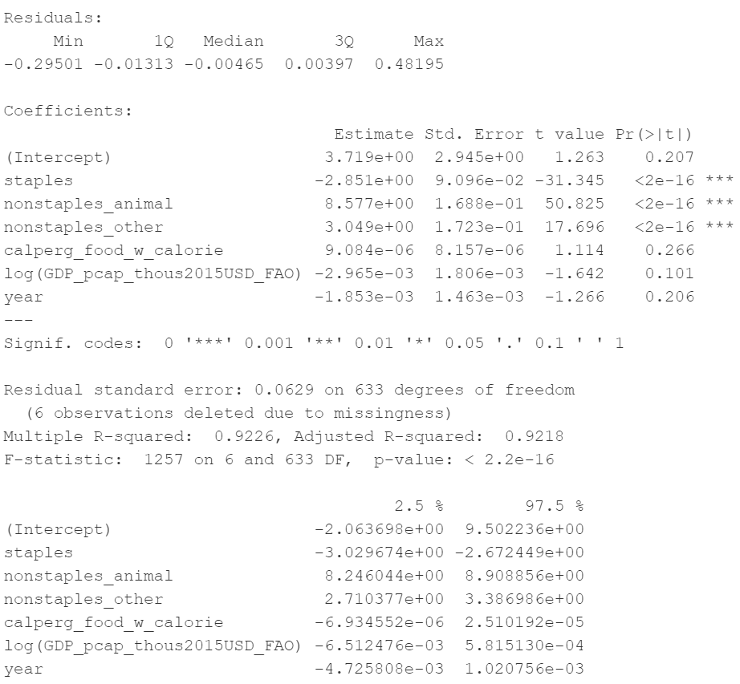
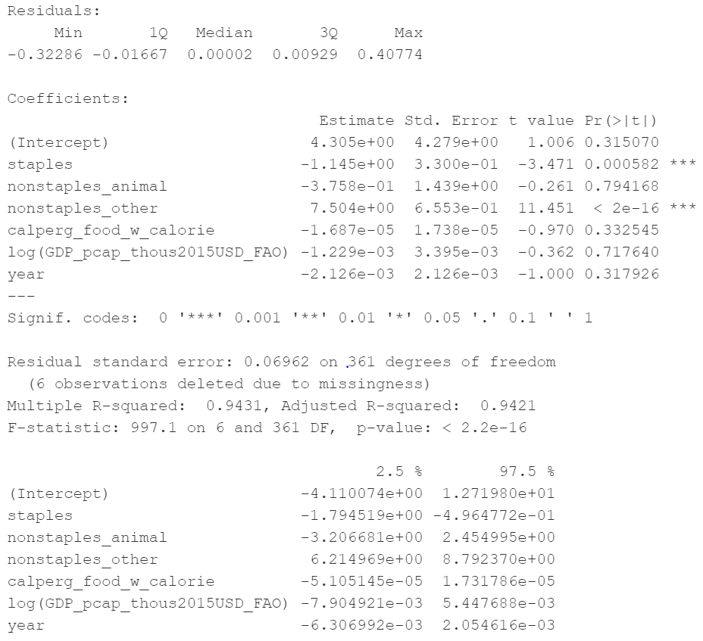
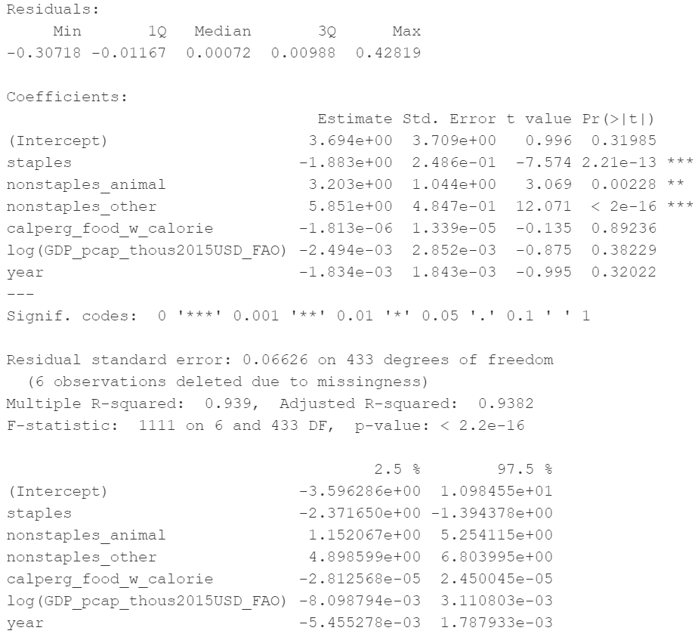
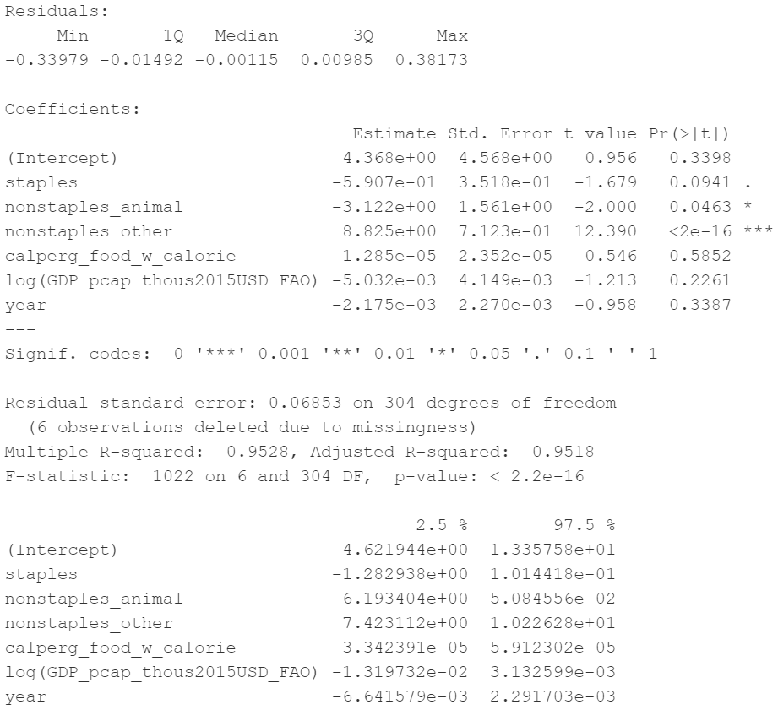
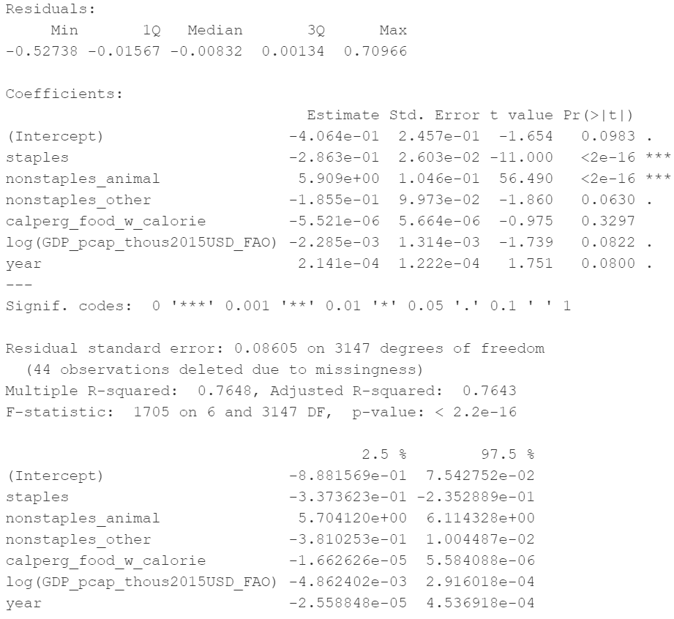
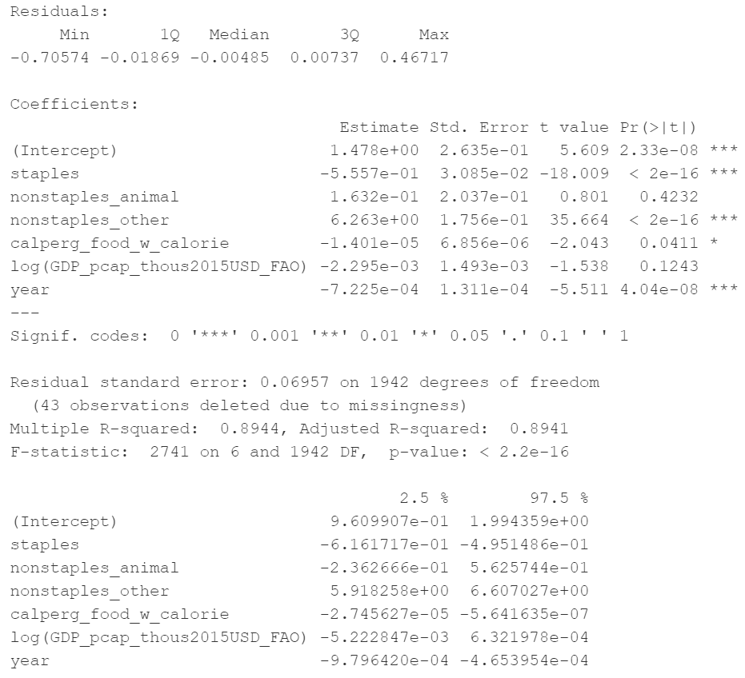

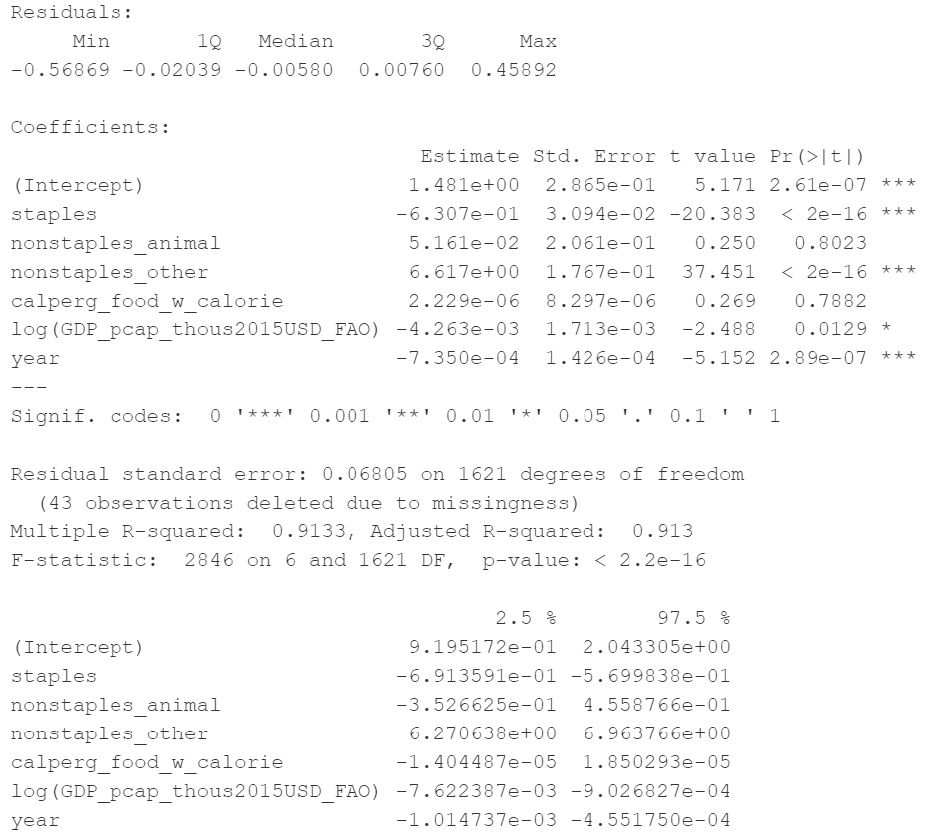
Food processing energy use and food production
Separating by type of food
2010-2015, all nonzero data
2010-2015, no fuels fully in non-specified industry
2010-2015, fractional energy constraints
2010-2015, fractional energy constraints by fuel
-
+
+
-
+
-
+
+
-
+
1973-2015, all nonzero data
1973-2015, no fuels fully in non-specified industry
1973-2015, fractional energy constraints
1973-2015, fractional energy constraints by fuel
-
+
-
+
-
+
-
+

Slide 19
Food processing energy use and food production
Initial model:
Food processing energy use ~ food production + GDP per capita + conversion rate of food to calories
+ interaction term: production*GDP per capita
+ interaction term: production*conversion rate of food to calories
2010-2015, all regions and years with nonzero food processing energy use and food production
Residual standard error: 0.08607 (~650 observations)
R squared: 0.8536
Coefficients:
Term | Coefficient | Significance
PKcal | 0.93 | Y
cal per g | -0.000069 | Y
GDP per cap (thous USD/person) | 0.0022 | Y
PKcal * tcal per g | -0.0012 | Y
Pkcal * GDP per cap | 0.045 | Y
(mean-centered values for independent variables)

Slide 20
Food processing energy use and food production
Initial model:
Food processing energy use ~ food production + GDP per capita + conversion rate of food to calories
+ interaction term: production*GDP per capita
+ interaction term: production*conversion rate of food to calories
1971-2015, all regions and years with nonzero food processing energy use and food production
Residual standard error: 0.08936 (~3150 observations)
R squared: 0.7459
Coefficients:
Term | Coefficient | Significance
PKcal | 0.97 | Y
cal per g | -0.000054 | Y
GDP per cap (thous USD/person) | 0.0018 | Y
PKcal * cal per g | -0.00081 | Y
Pkcal * GDP per cap | 0.032 | Y
(mean-centered values for independent variables)

Slide 21
Food processing energy use and food production
Initial model:
Food processing energy use ~ food production + GDP per capita + conversion rate of food to calories
+ interaction term: production*GDP per capita
+ interaction term: production*conversion rate of food to calories
2010-2015, all regions and years with nonzero food processing energy use and food production, and where no fuels are fully allocated to other industry (~370 observations)
Residual standard error: 0.07879
R squared: 0.9259
Coefficients:
Term | Coefficient | Significance
PKcal | 2.4 | Y
cal per g | 0.00013 | Y
GDP per cap (thous USD/person) | 0.00049 | Y
PKcal * cal per g | 0.0037 | Y
Pkcal * GDP per cap | 0.0059 | Y
(mean-centered values for independent variables)

Slide 22
Food processing energy use and food production
Initial model:
Food processing energy use ~ food production + GDP per capita + conversion rate of food to calories
+ interaction term: production*GDP per capita
+ interaction term: production*conversion rate of food to calories
2010-2015, all regions and years with nonzero food processing energy use and food production, and where no fuels are fully allocated to other industry (~370 observations)
Residual standard error: 0.07879
R squared: 0.9259
Coefficients:
Term | Coefficient | Significance
PKcal | 2.4 (vs 0.93) | Y
cal per g | 0.00013 (vs -0.000069) | Y
GDP per cap (thous USD/person) | 0.00049 (vs 0.0022) | Y
PKcal * cal per g | 0.0037 (vs -0.0012) | Y
Pkcal * GDP per cap | 0.0059 (vs 0.045) | Y
(mean-centered values for independent variables)

Slide 23
Food processing energy use and food production
Initial model:
Food processing energy use ~ food production + GDP per capita + conversion rate of food to calories
+ interaction term: production*GDP per capita
+ interaction term: production*conversion rate of food to calories
1971-2015, all regions and years with nonzero food processing energy use and food production, and where no fuels are fully allocated to other industry (~1950 observations)
Residual standard error: 0.08996
R squared: 0.8228
Coefficients:
Term | Coefficient | Significance
PKcal | 1.3 | Y
cal per g | -0.000023 | Y
GDP per cap (thous USD/person) | 0.0013 | Y
PKcal * cal per g | -0.00022 | Y
Pkcal * GDP per cap | 0.0033 | Y
(mean-centered values for independent variables)

Slide 24
Food processing energy use and food production
Initial model:
Food processing energy use ~ food production + GDP per capita + conversion rate of food to calories
+ interaction term: production*GDP per capita
+ interaction term: production*conversion rate of food to calories
1971-2015, all regions and years with nonzero food processing energy use and food production, and where no fuels are fully allocated to other industry (~1950 observations)
Residual standard error: 0.08996
R squared: 0.8228
Coefficients:
Term | Coefficient | Significance
PKcal | 1.3 (vs 0.97) | Y
cal per g | -0.000023 (vs -0.000054) | Y
GDP per cap (thous USD/person) | 0.0013 (vs 0.0018) | Y
PKcal * cal per g | -0.00022 (vs -0.00081) | Y
Pkcal * GDP per cap | 0.0033 (vs 0.032) | Y
(mean-centered values for independent variables)

Slide 25
Food processing energy use and food production
Initial model:
Food processing energy use ~ food production + GDP per capita + conversion rate of food to calories
+ interaction term: production*GDP per capita
+ interaction term: production*conversion rate of food to calories
2010-2015, all regions and years with fractions of total industry energy used in food processing and other industry are within specified ranges (~440 observations)
Residual standard error: 0.08996
R squared: 0.8228
Coefficients:
Term | Coefficient | Significance
PKcal | 2.2 | Y
cal per g | 0.000069 | Y
GDP per cap (thous USD/person) | 0.0010 | Y
PKcal * cal per g | 0.0025 | Y
Pkcal * GDP per cap | 0.015 | Y
(mean-centered values for independent variables)

